Slide 1
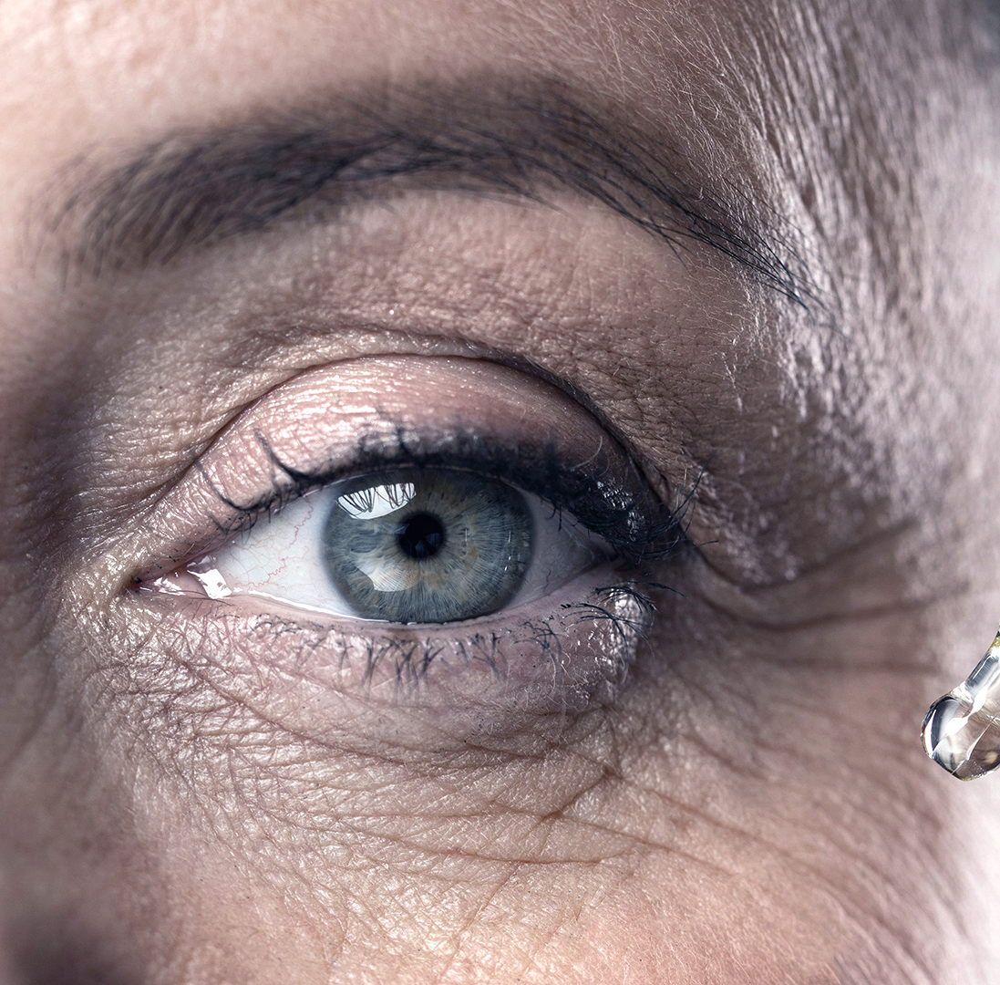
Diabetes Detection System Using Iridology
Under Supervision
DR: Hamada Nayel.

Slide 2
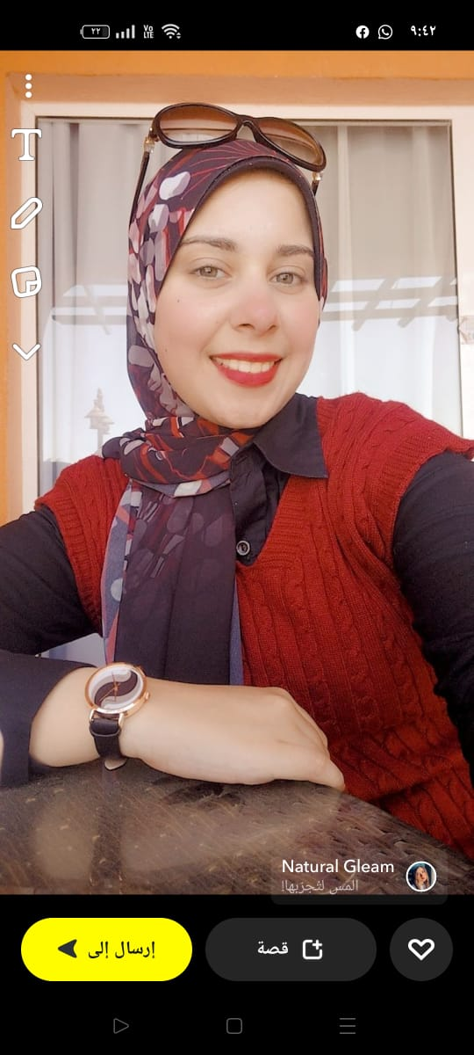
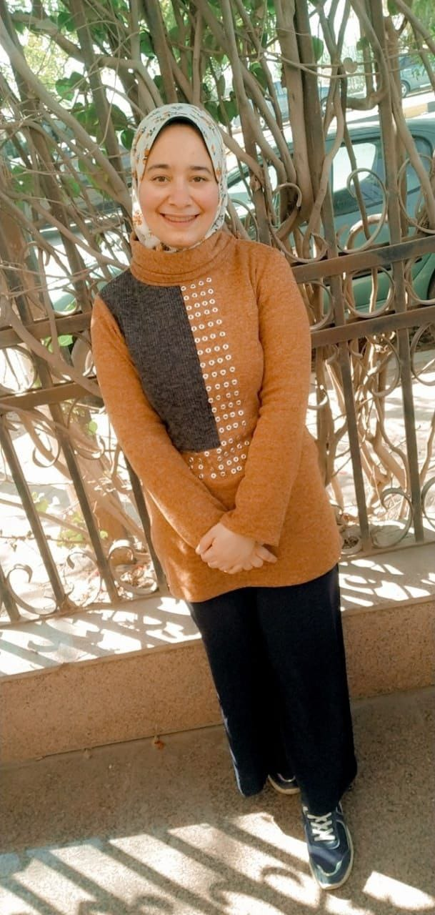

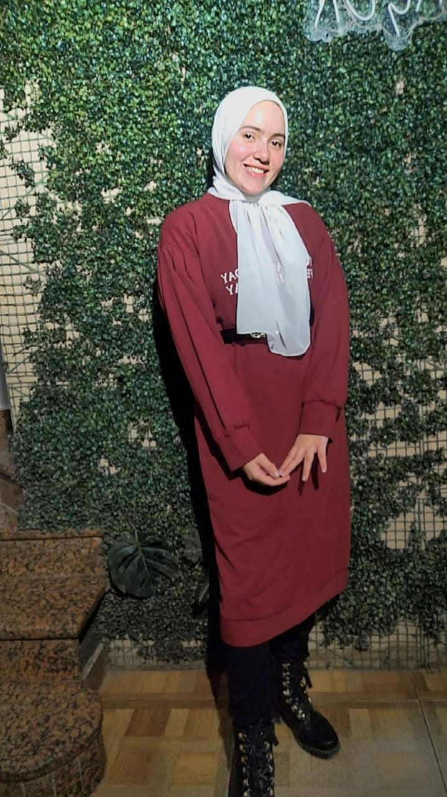

Our Team
Marwa Ashraf Ahmed
Tasnim Ahmed Fathy
Mariam Ahmed Imamm
Aya Goda Elsayed
Momen Alaa Elroweny

Slide 3
Agenda
01
01
02
03
04
05
06
Proposed Solution.
Introduction.
Problem Definition.
Motivation.
Objectives.
Dataset.
07
08
09
Analysis.
System Design.
Methodologies.
10
11
Database Tables.
Models.

Slide 4
Introduction
Recently, many serious diseases that threaten human health and life have spread , an example of these diseases is diabetes.
Diabetes : disease whose initial symptoms are often undetectable so many cases of diabetes are not detected early.
Leading to an exacerbation of the disease and the emergence of serious complications.
Early detection of diabetes is one of the most essential health requirements at present.

Slide 5
Problem Definition
Current solutions for diagnosing of diabetes must always be established by a blood glucose measurement made in an accredited laboratory.
It is not an effective method as it takes time for the blood to be analyzed and provide results in addition to being inaccurate in some cases.
Therefore, we need a tool used to identify pancreatic damage as an indication of diabetes through iridology.

Slide 6
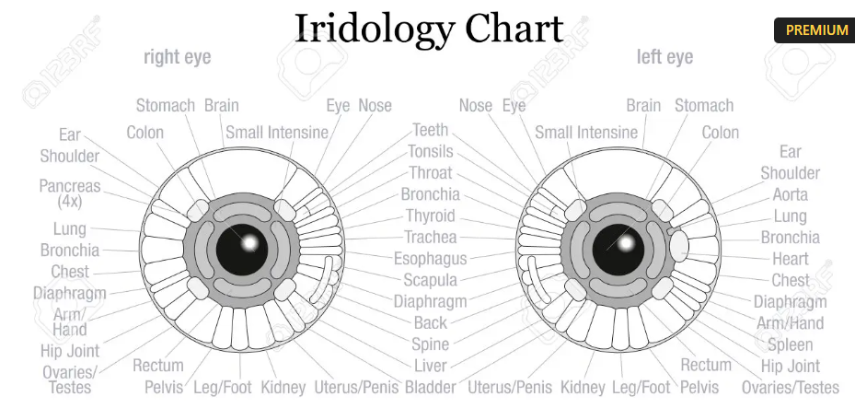
Proposed Solution
Iridology is an effective alternative method to detect diabetes early.
Iridology is an alternative medical technology that examines colors, patterns and other features of the iris of the eye that can be used to determine the patient's systemic health condition.
Iridologists compare their observations with iridology charts.

Slide 7
Motivations
The Spread of diabetes among people dramatically.
Provide time and effort (medical tests such as
blood test – urine test).
Get the highest possible accurate for the result.
Knowing if patient suffer from diabetes or not and its level and
it is very important especially for old people.

Slide 8
Objectives
Helping doctors in medical field by creating an efficient and accurate software that help them to detect Diabetes quickly and determine its degree.
Designing a system that saves time and effort of detecting diabetes .
Providing an alternative to traditional diagnostic methods such as blood tests and urine tests.
Obtaining accurate results, the percentage of error is minimal.

Slide 9
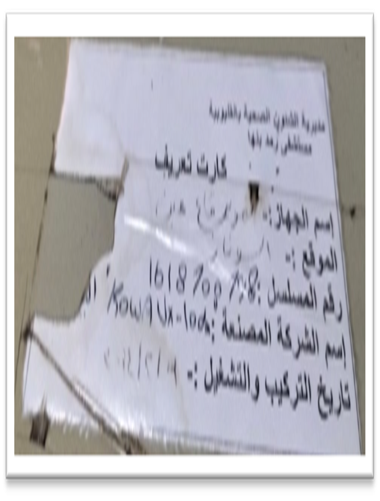
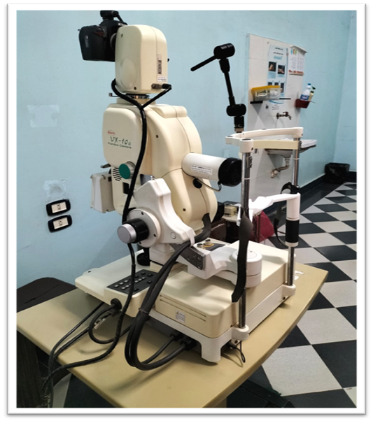
Tools for Collecting The Dataset
Fig 1: Fundus Camera
Fig 2: Identification card

Slide 10

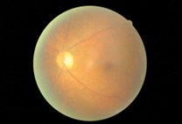
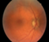
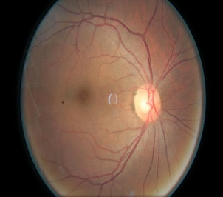

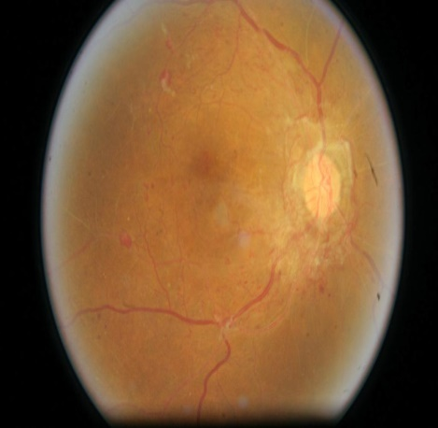
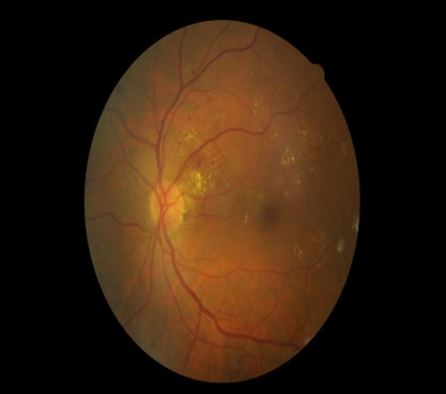
Examples of Eye Images from Dataset
2- Mild
3- Moderate
1- No diabetes
4- Severe
5- Proliferative DR

Slide 11
Naming Dataset
After collecting Dataset We have numbered the patients as typeing the image’s number then left or right based on the image, like 111_left.

Slide 12
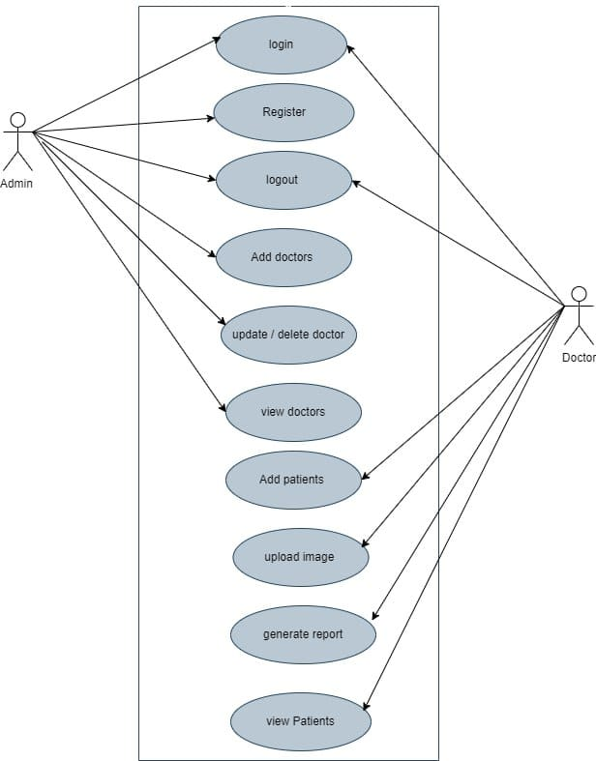
Analysis and Design
1-Use Case Diagram

Slide 13
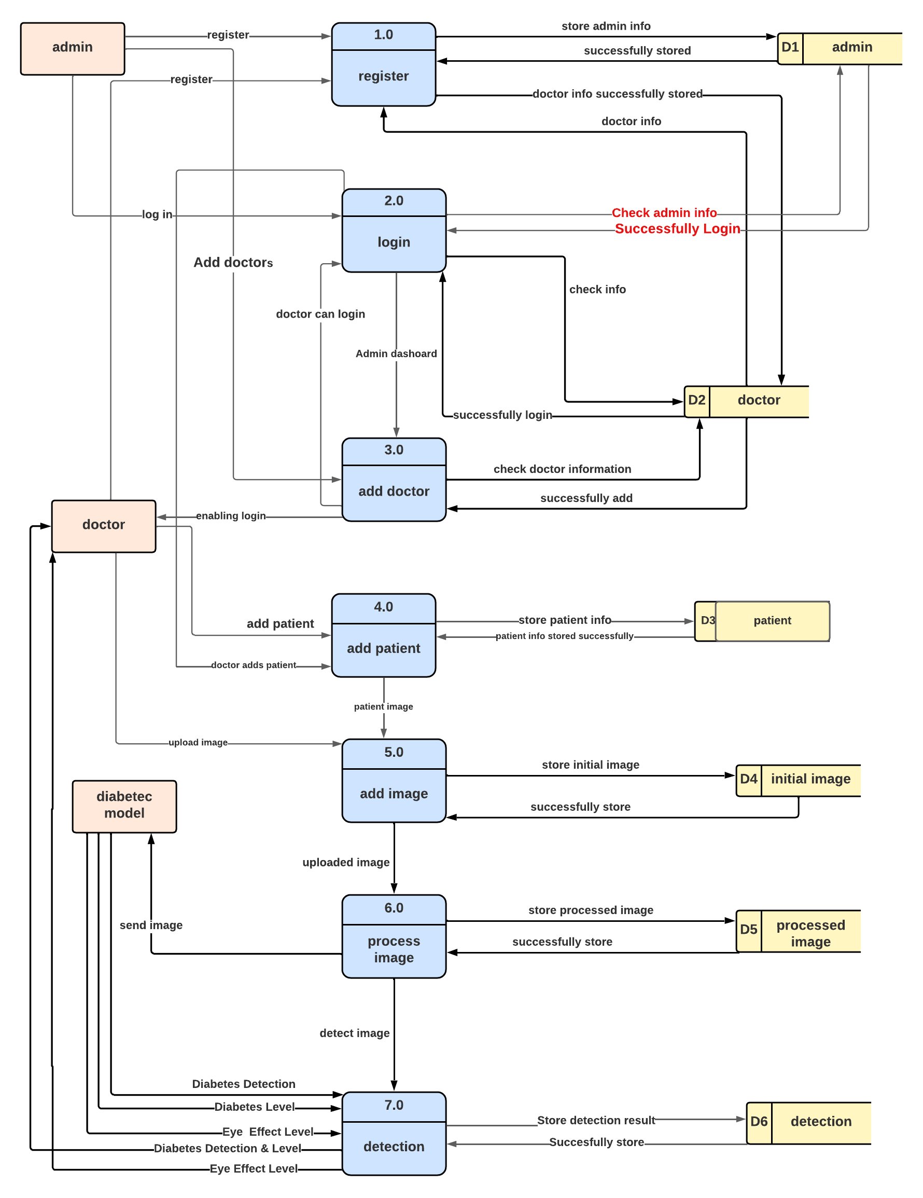
Analysis and Design
2-Dfd level 0

Slide 14
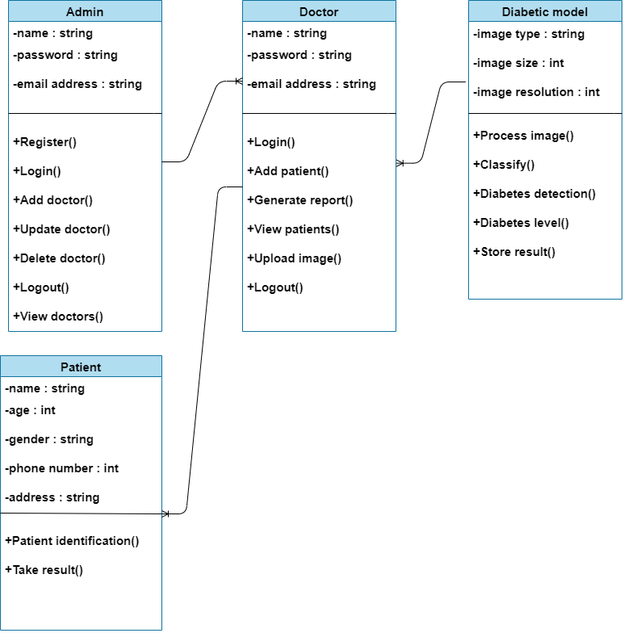
Analysis and Design
3-Class Diagram

Slide 15






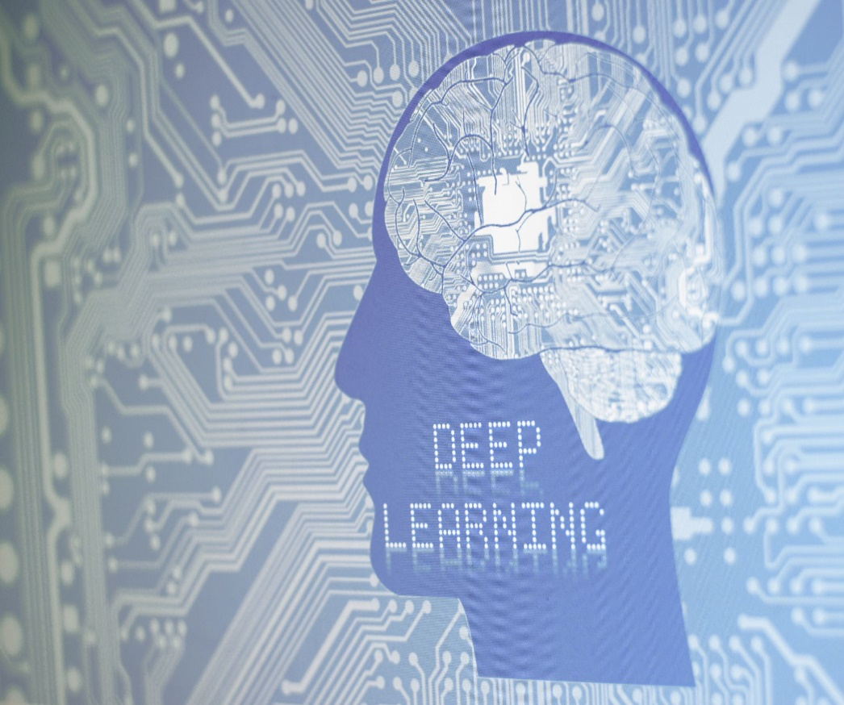
Methodologies

Slide 16
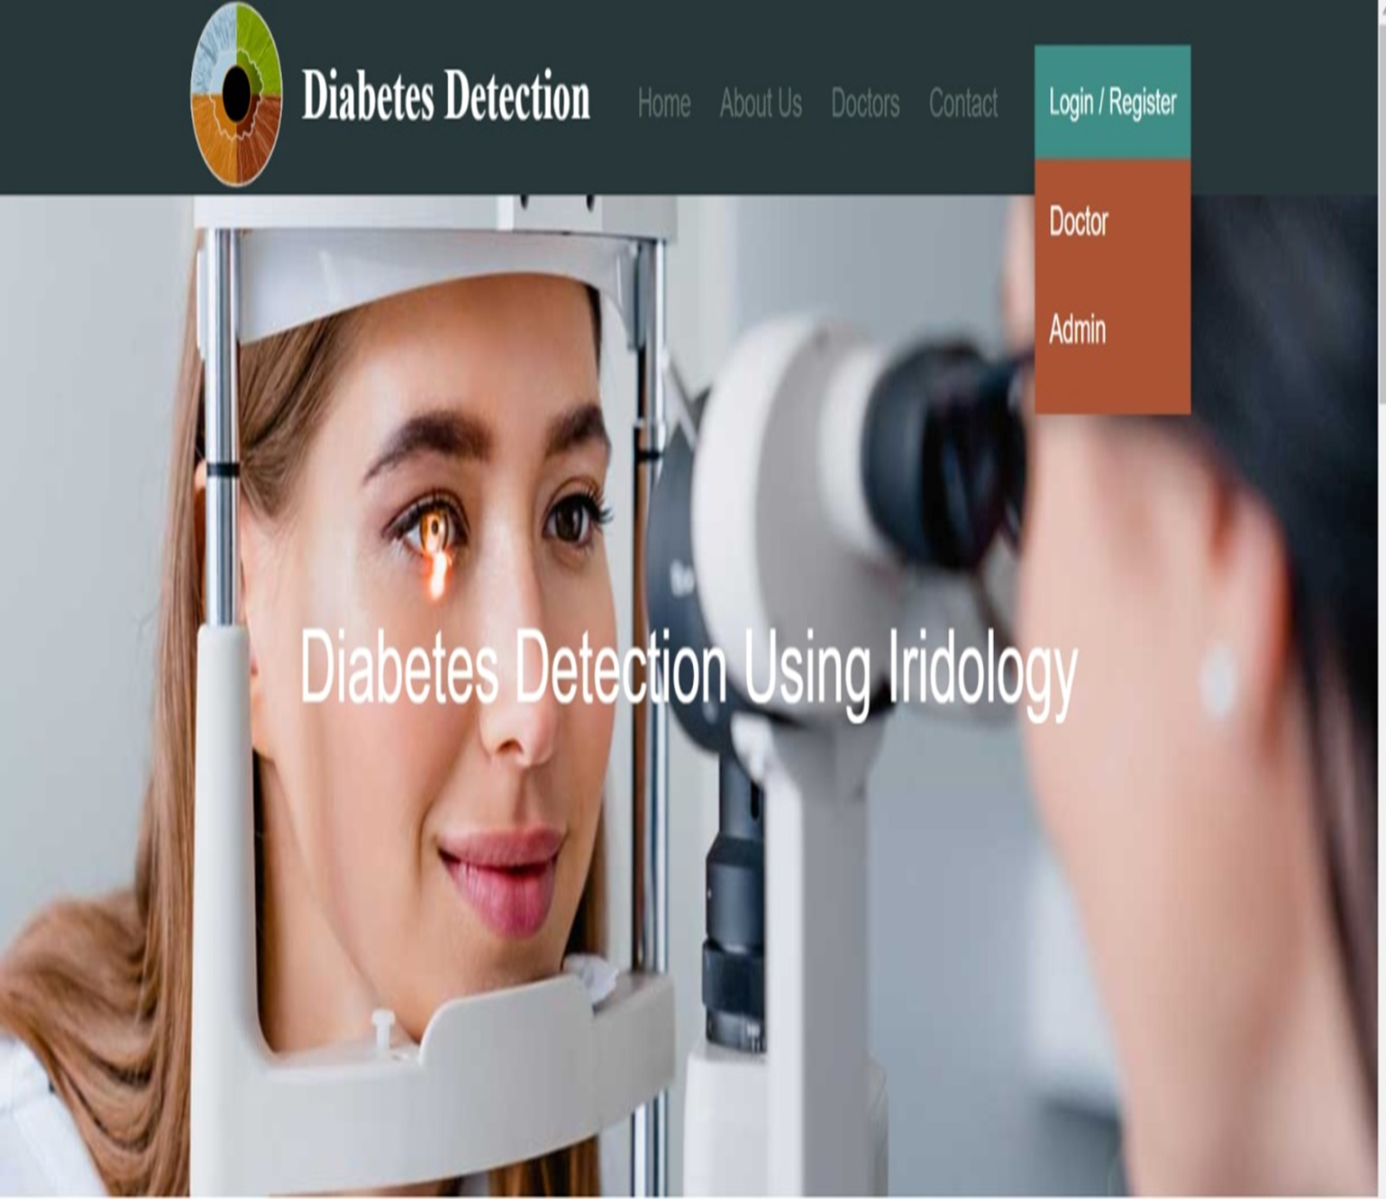
System Design Home page

Slide 17
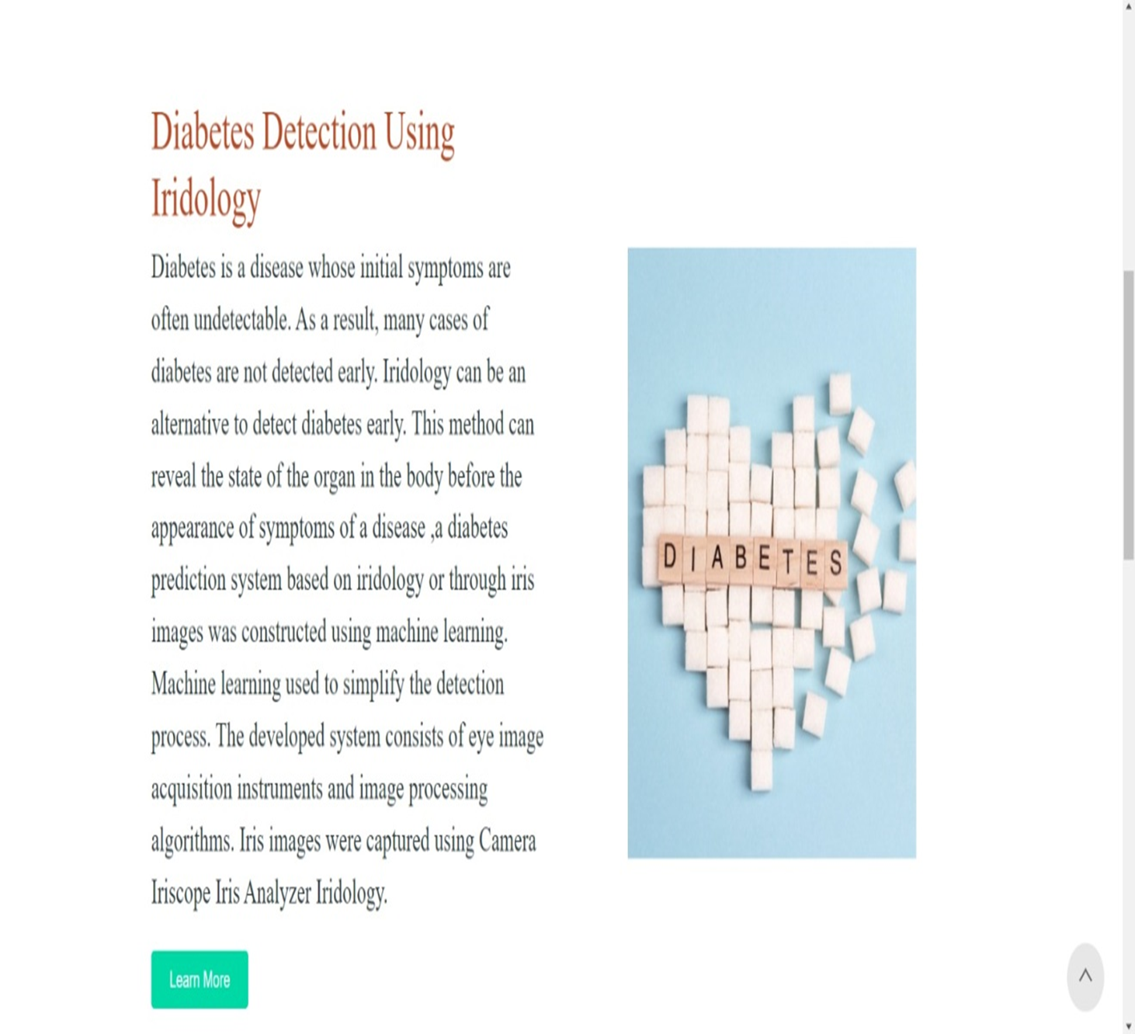
System Design Home page

Slide 18
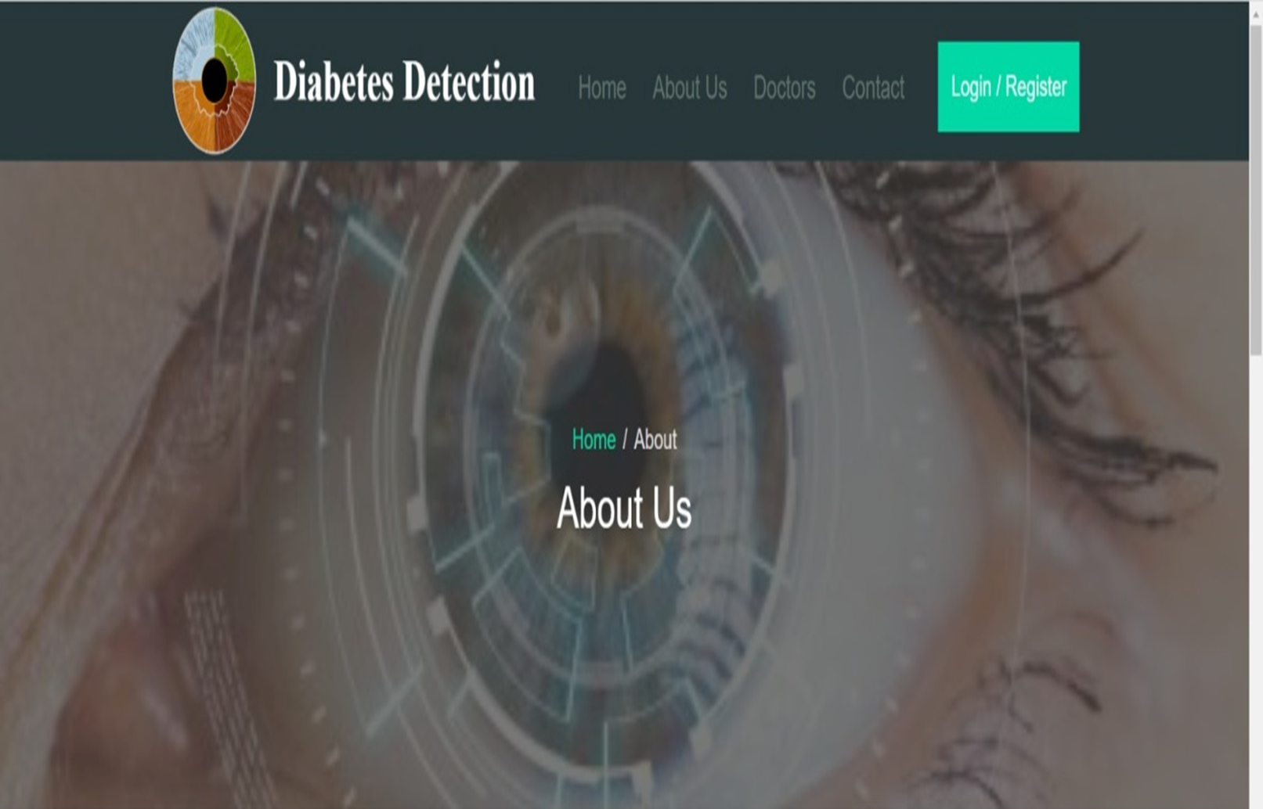
System Design About us page

Slide 19
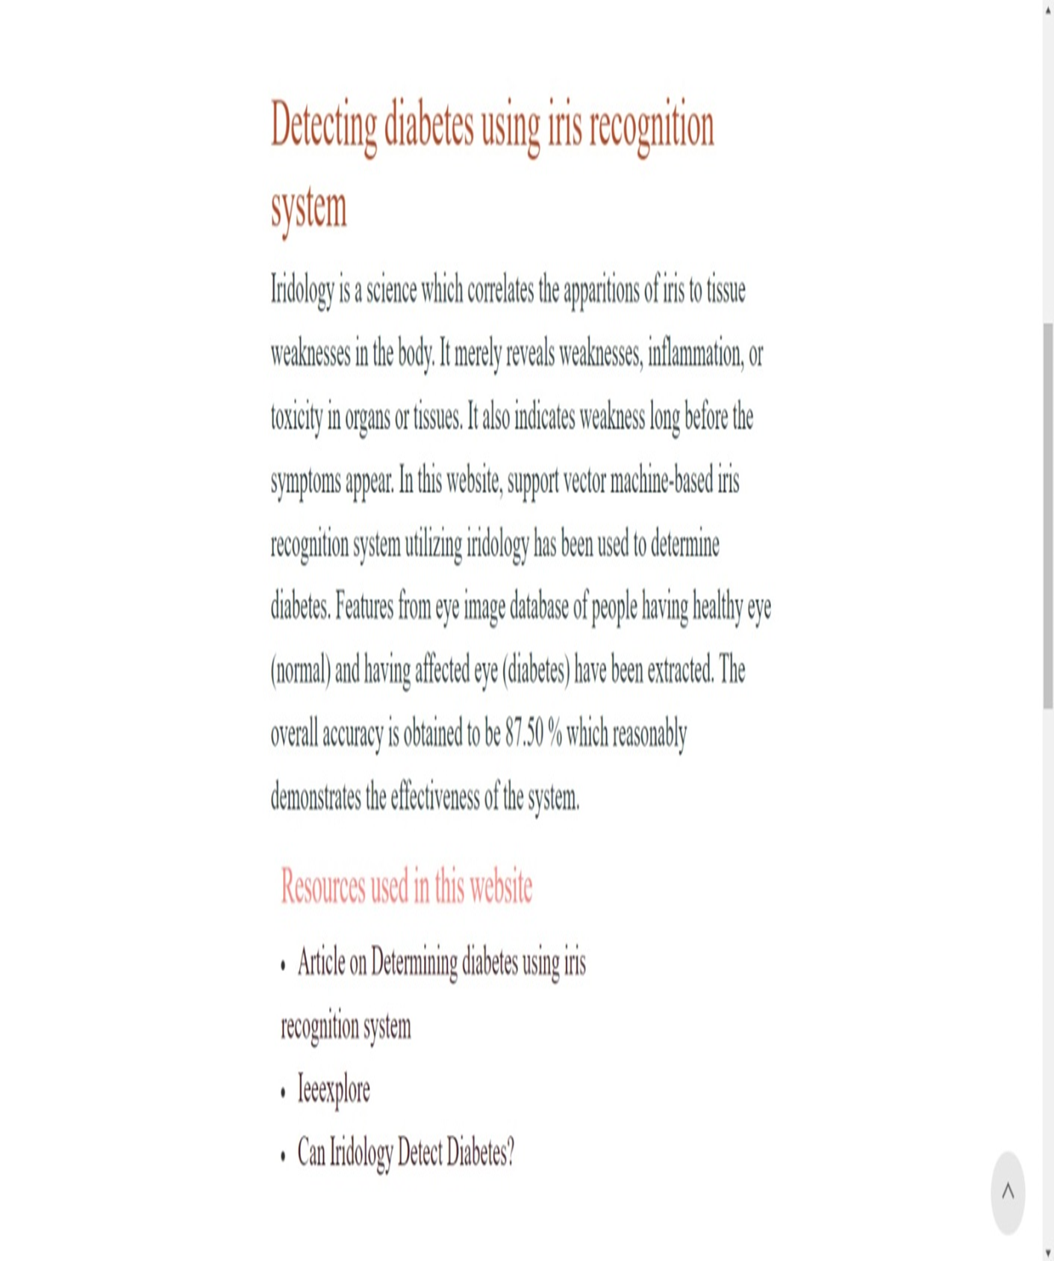
System Design About us page

Slide 20
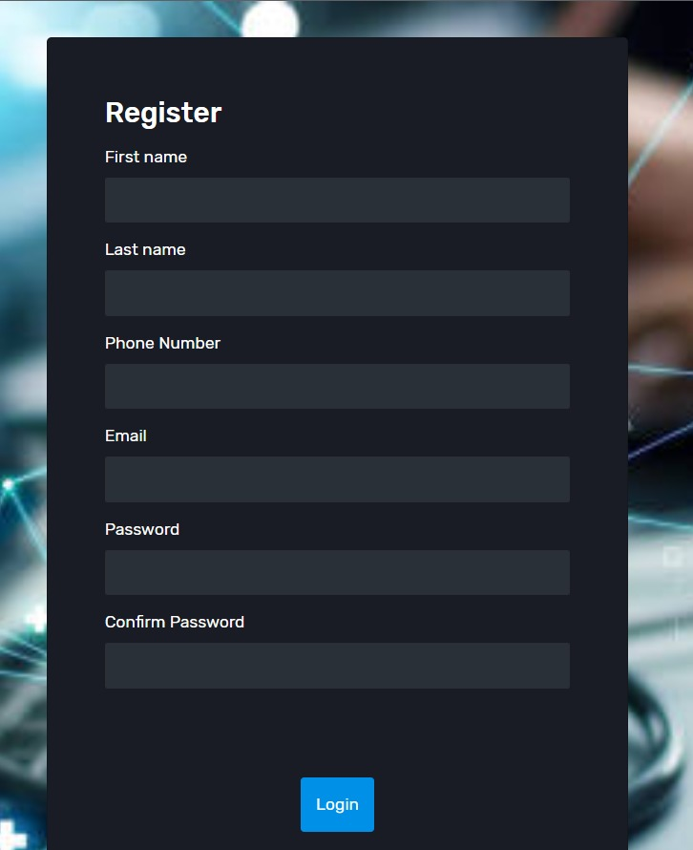
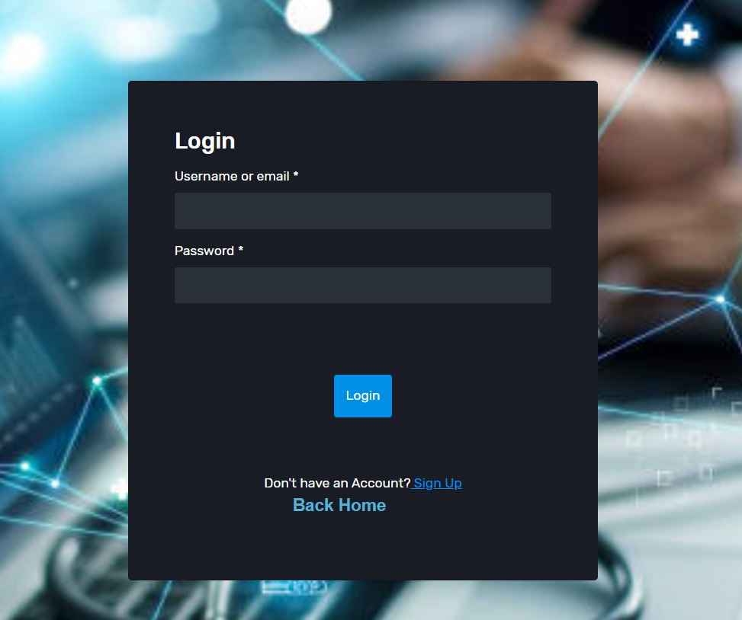
System Design Admin Register Admin login

Slide 21
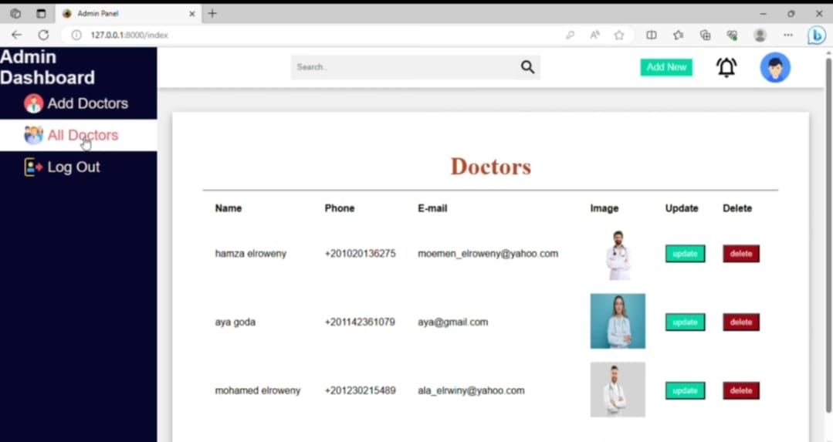
System Design Admin dashboard

Slide 22
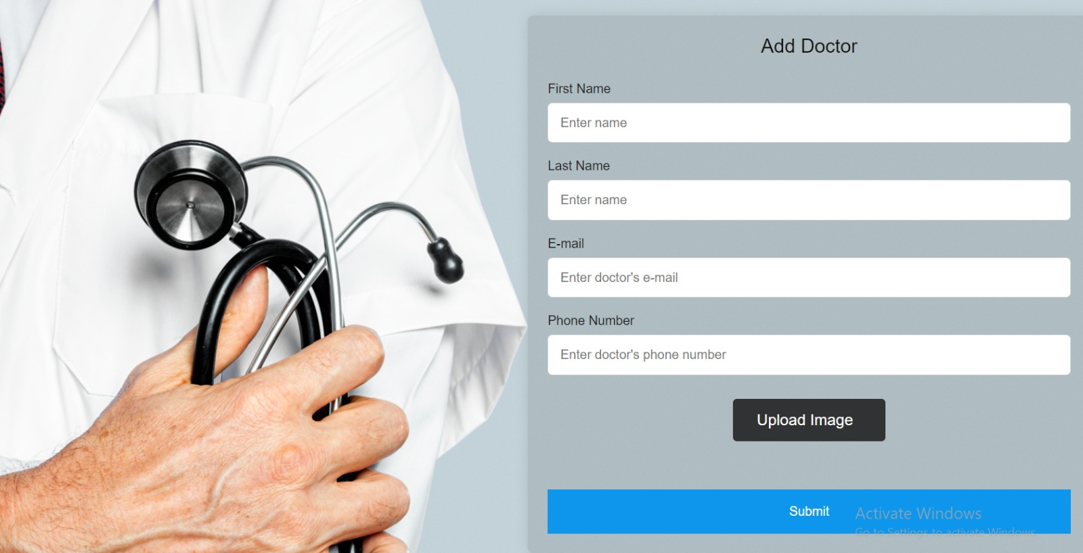
System Design Add Doctor Page

Slide 23
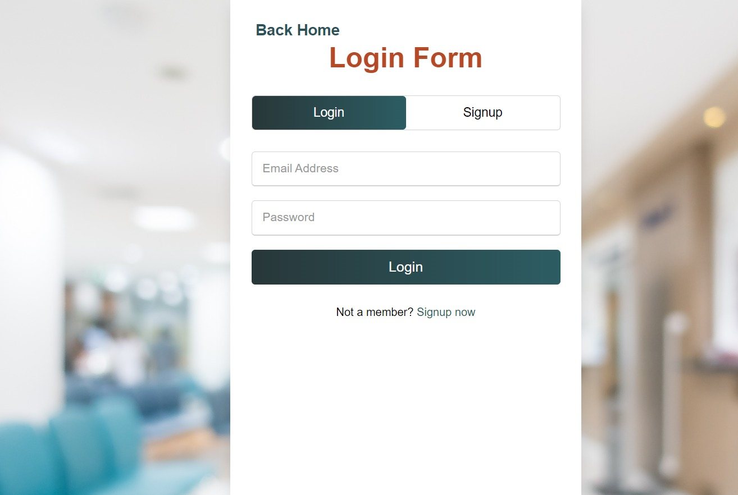
System Design Doctor login

Slide 24
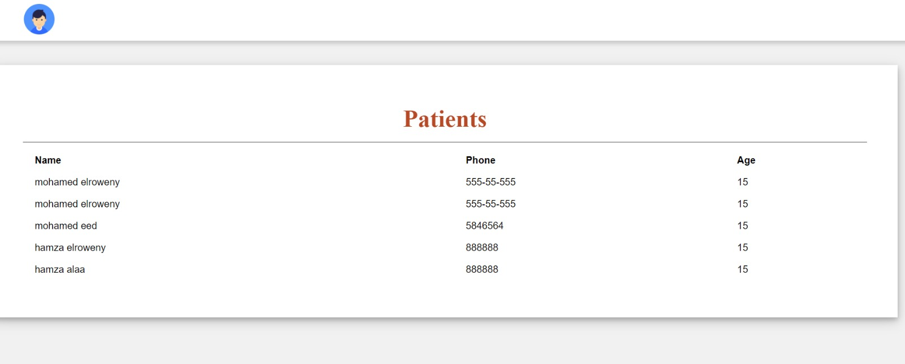
System Design All Patients Page

Slide 25
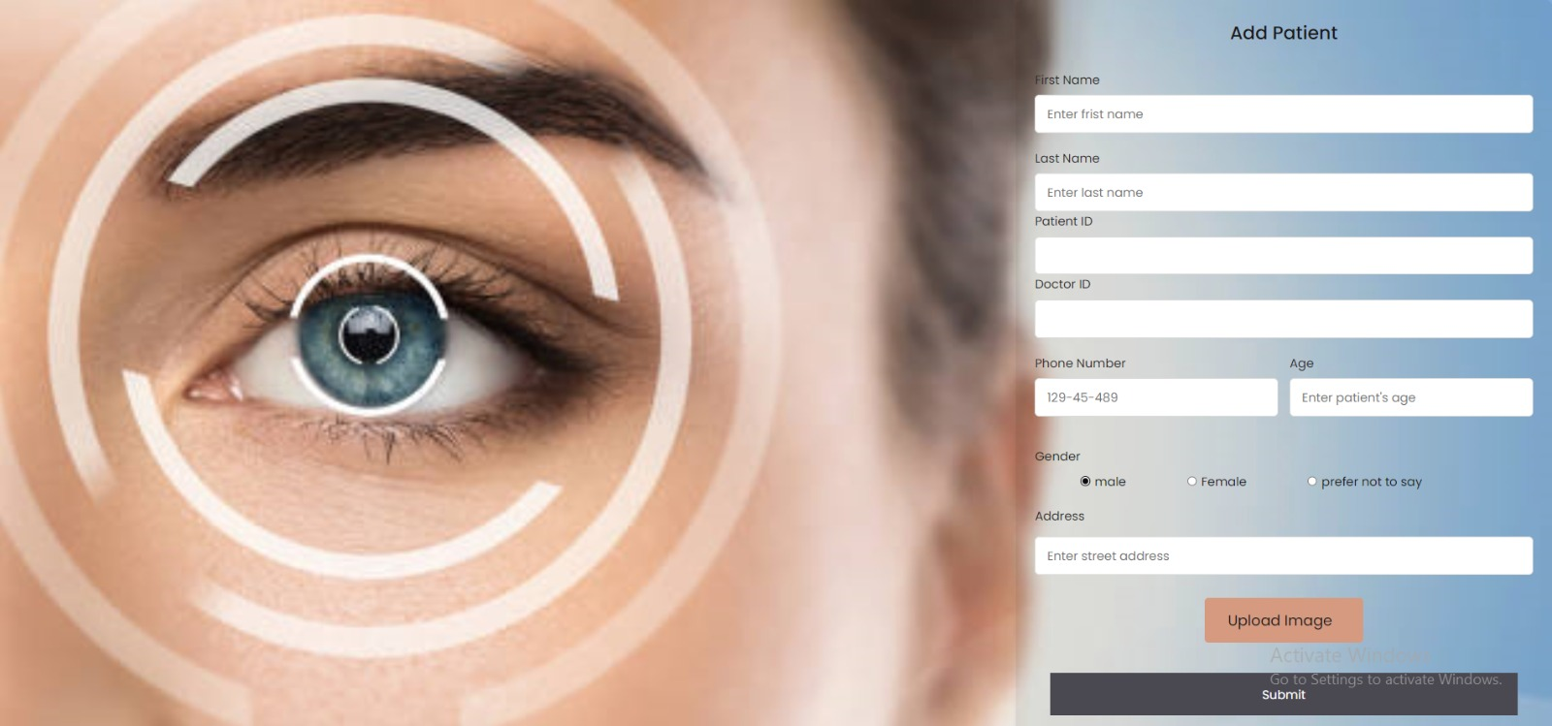
System Design Add Patient Page

Slide 26
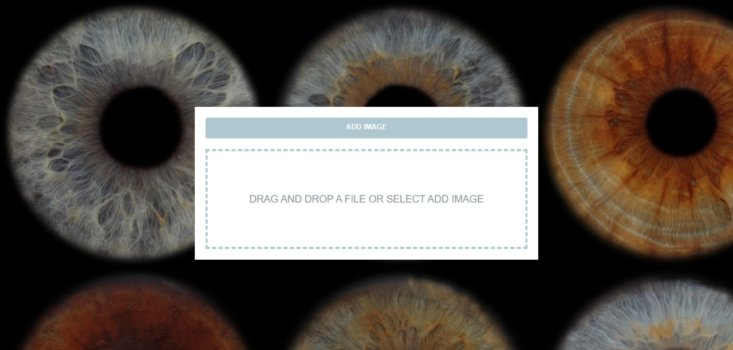
System Design Upload the eye image Page

Slide 27
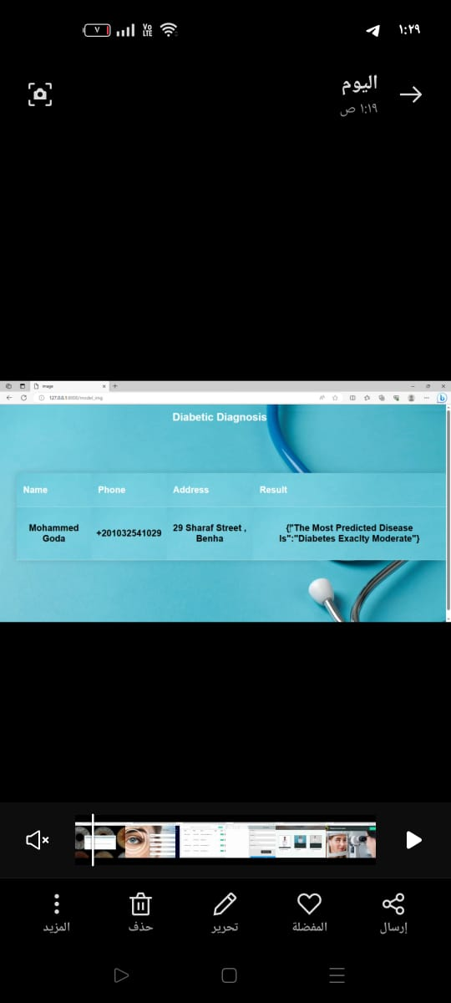
System Design The report generated by the system

Slide 28
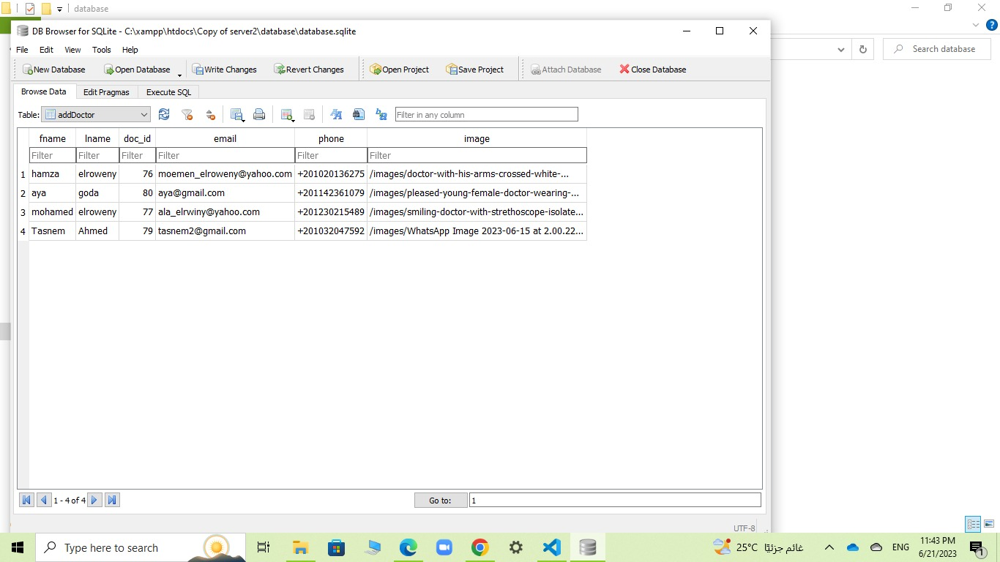
Database Tables Add doctor table

Slide 29
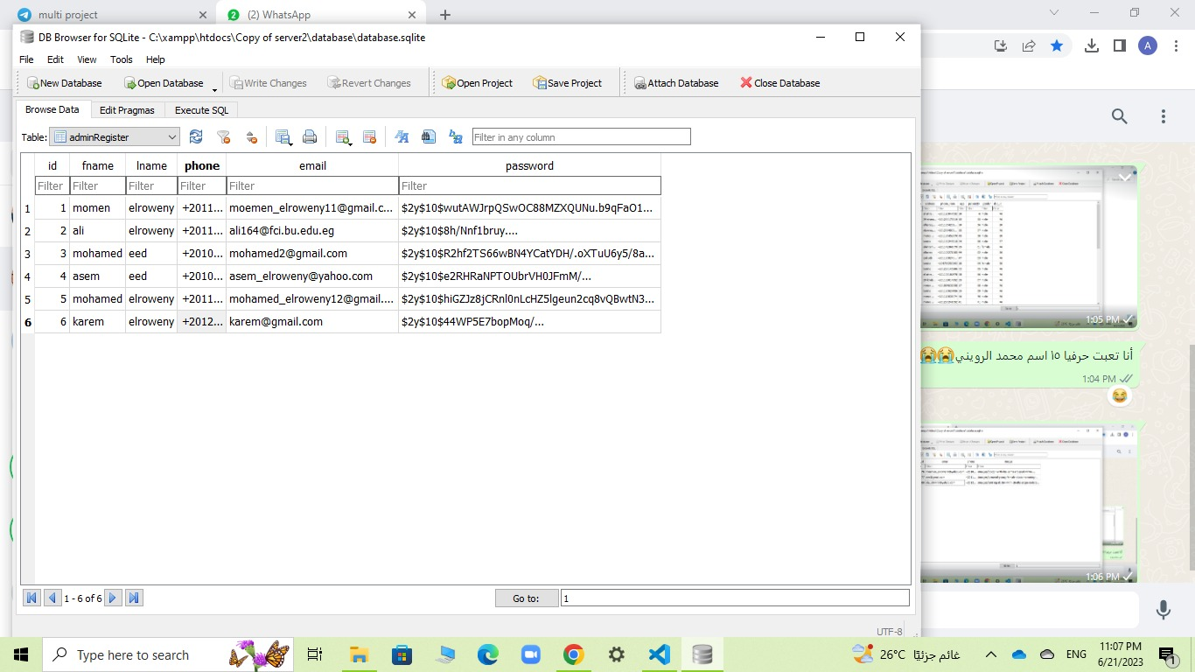
Database Tables Admin register table

Slide 30
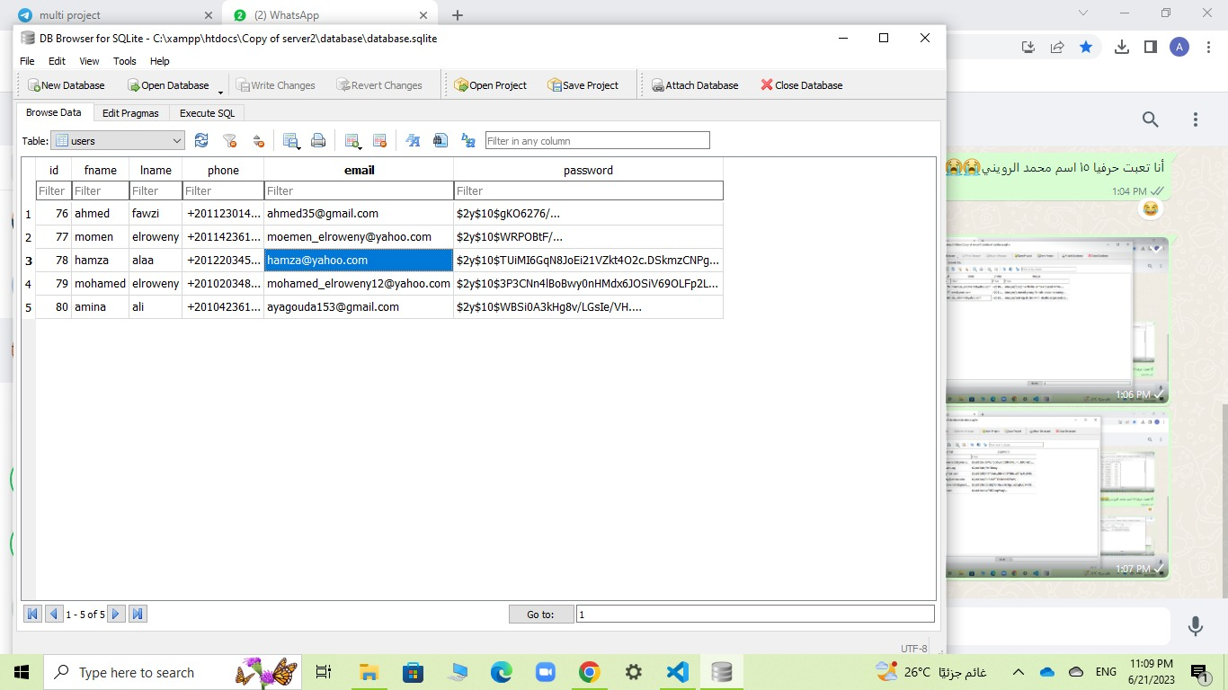
Database Tables Users table

Slide 31
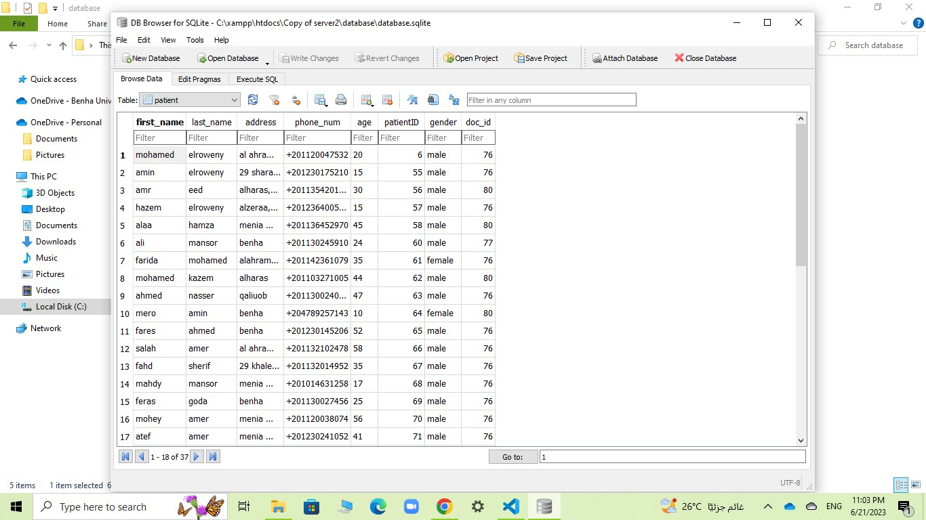
Database Tables Patient table

Slide 32
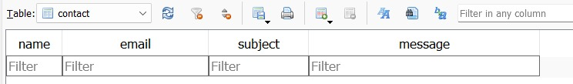
Database Tables Contact table

Slide 33
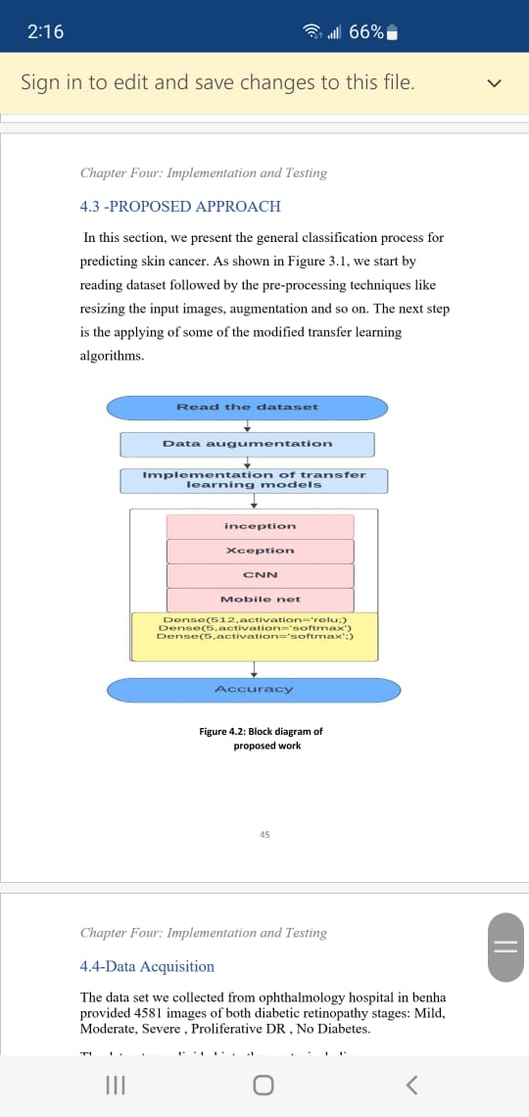
Block Diagram of Proposed Work

Slide 34
Spliting & Reading Data set
we have 4581 image splited as:
training set with 3436 images, a validation set with 687 images, and a testing set.
Training | 0.75
Validation | 0.15
Testing | 0.10
We read images using Image Generator

Slide 35
Data preprocessing
Data Augmentation:
adjust_contrast
equalization
conversion
transforming to 224 x 224x 3 dimensions .

Slide 36
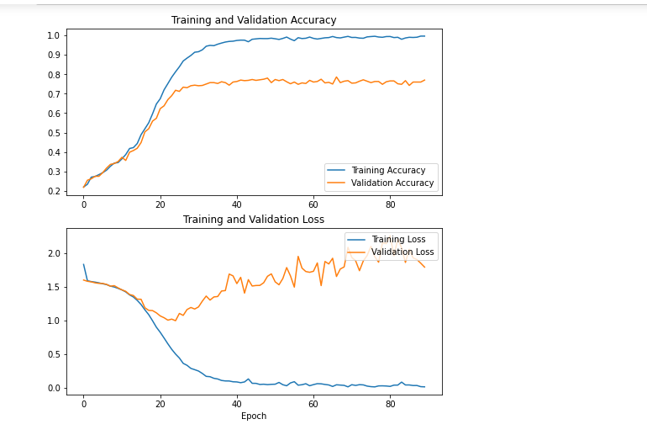
CNN model

Slide 37
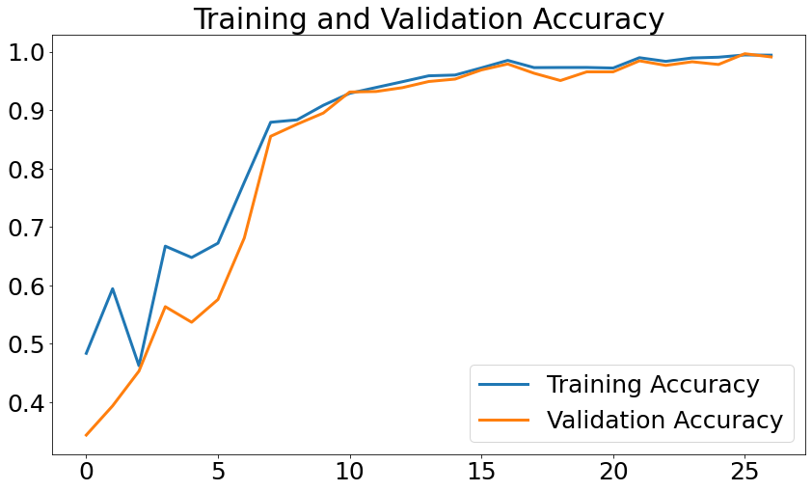
Xception model

Slide 38
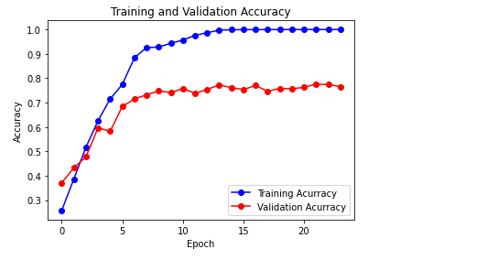
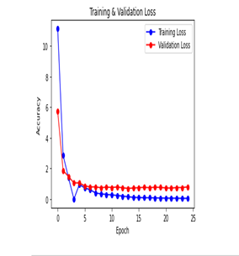
Inception model

Slide 39
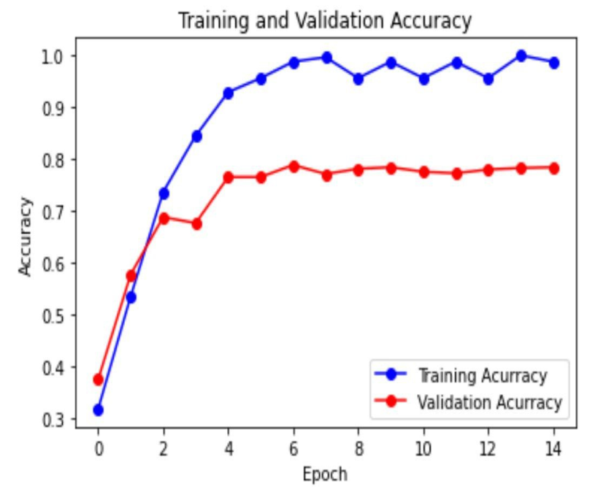
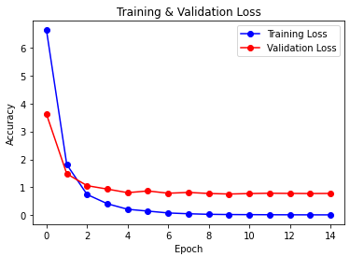
Mobilenet v2 model

Slide 40
Models Accuracy
Model | Accuracy
Mobile net v2 model | 78%
CNN | 76.9%
Xception | 76.5%
Inception | 75.5%

Slide 41
Future work
We would like the system to work in the future in all hospitals to make diabetes detection easier.
We seek to develop services provided by website.
Will add new services for the system such as Connect the fundus camera to the system to insert fundus images that were taken directly into the system.
We strive to meet the requirements of users and provide a high level of comfort for them.
Taking end-user feedback and improving the system.

Slide 42
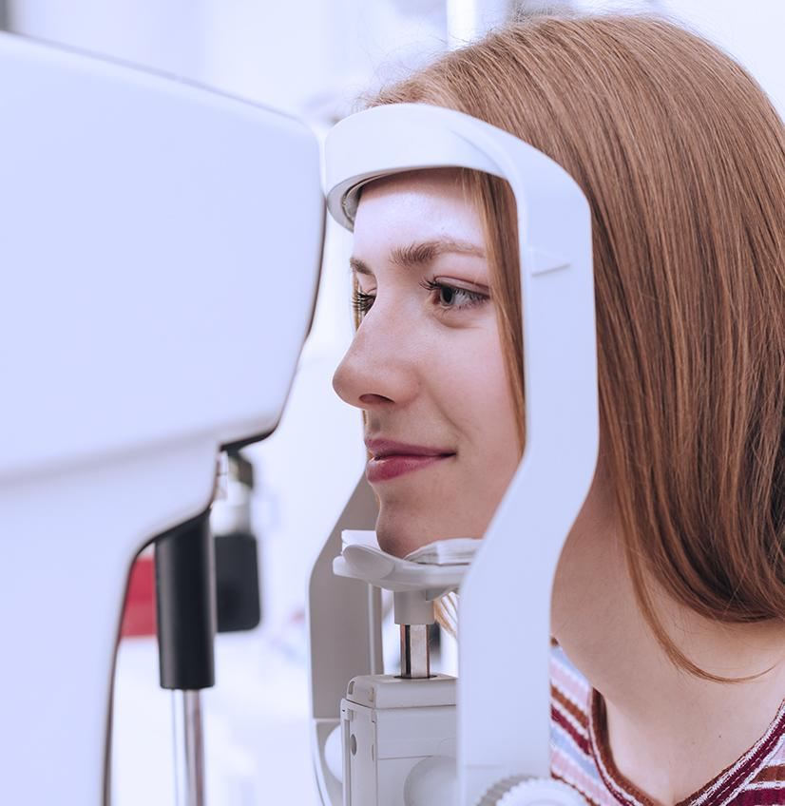
Thanks

